Slide 1










Feature Significance in Wide Neural Networks
Janusz A. Starzyk
starzykj@ohio.edu
Google: Janusz Starzyk
Rafał Niemiec
rniemiec@wsiz.rzeszow.pl
Google: Rafał Niemiec
Adrian Horzyk
horzyk@agh.edu.pl
Google: Horzyk
1
2
2
3
1
2
3
Ohio University,
Athens, Ohio, U.S.A.,
School of Electrical
Engineering and
Computer Science
University of
Information
Technology and Management,
Rzeszow, Poland
AGH University of
Science and Technology
Krakow, Poland
Notes:
1

Slide 2
Introduction
Wide neural networks was recently proposed as a less costly alternative to deep neural networks, having no problem with exploding or vanishing gradient descent.
We analyzed quality of features and properties of wide neural networks.
We compared the random selection of weights in the hidden layer to the selection based on radial basis functions.
Our study is devoted to feature selection and feature significance in wide neural networks.
We introduced a measure to compare various feature selection techniques.
We proved that this approach is computationally more efficient.
2
Notes:
2
Wide neural networks were recently proposed as a less costly alternative to deep neural networks. In this paper, we analyze the properties of wide neural networks regarding feature selection and their significance. We compared the random selection of weights in the hidden layer to the selection based on radial basis functions. Wide neural networks were also compared with fully connected cascade networks. Feature significance was introduced as a measure to compare various feature selection techniques. Another performance measure introduced in this paper – incremental feature significance - determines the level of improvement that results from selecting only some features, which were added to the existing features, rather than replacing one set of features with another. In both cases, we can also estimate the number of features saved by replacing the original features with the selected ones for which recognition levels improve. This approach can be applied to wide networks that use different feature selection methods than those that are analyzed in this paper; like a k-nearest neighbor, an autoencoder etc.

Slide 3
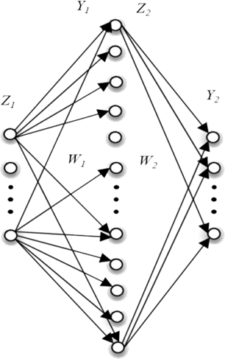
Wide (Broad) Neural Network
C.L.P. Chen, and Z. Liu, “Broad Learning System: An Effective and Efficient Incremental Learning System Without the Need for Deep Architecture”, IEEE Transactions on Neural Networks and Learning Systems, Vol. 29 , Issue: 1 , Jan. 2018, pp. 10-24.
Wide Neural Networks can be described by the equations:
Y₁ = Z₁ · W₁
Z₂ = Ψ(Y₁)
Y₂ = Z₂ · W₂
W₂ = Z₂⁺ · Y_{D}
ASSUMED
(it is usually randomly generated, but we propose
a different approach to save the number of necessary neurons and connections)
We try to measure
the feature quality if the assumption
was correct
COMPUTED
using pseudoinverse
3
They were from 276 to 1543 times faster trained than autoencoders, multilayer perceptrons, and deep neural networks.
Notes:
3
On the right, we can see a wide neural network that can be described by the following equations.
Where Z1 is an input vector, W1 is a weight vector that can be differently generated or computed, psi is a non-linear function, Z2 is the output vector of the hidden neurons, W2 is a computed weight vector using pseudoinverse, and Y2 is a vector of the outputs of the output layer neurons.
In this work, we compared various approaches of generation of W1 matrix and the feature efficiency of such networks.
[For the network output Y_{D} / Z₂, we get W₂Z₂/Z₂=W₂, where Z₂⁺ is a left inverse of Y_{D}. That is, Z₂⁺ Y_{D}=W₂. The problem is, there is no exact left inverse if there is a left nullspace. As is in the case of Z₂, the output of non-linear ψ. It is all about nonlinearity, to not to preserve orthogonality of some columnspace vectors. It is possible that a neuron computes on a left nullspace. What is there? Z₂Y_{D}=0 solutions. Nonlinearity guarantees the presence of left nullspace.]
Internal message: Can we guarantee it in other way? :) Maybe it is worth to check? But this cannot be an open question. If neuron really computes on a left nullspace, than – at least part of - the process of learning is a process of forgetting.
We use pseudoinverse to invert Z₂. I will show why it works but first consider model weights. One can compute W₂, but not W₁. These weights are assumed. Our study is devoted to the development of simple measure techniques, to get insight into this assumption by observation.

Slide 4
Neural Features
Ψ
INPUT
FEATURES
OUTPUT
FEATURES
NEURAL
FEATURES
It is all about W₁ proper column space setup.
4
Z₁ W₁ W₂ Y₂
kxm mxn nxo kxo
Notes:
4
We consider four matrices Z₁^{k×m}, W₁^{m×n}, W₂^{n×o} and Y₂^{k×o}. We say that Z1 input consist of k examples seen through the m features. Thus, a single input feature is a vector in a column space of an input matrix Z1. There is m such features (or attributes) and a single example (or an object descriptor; or an case) has m own values on m descriptor’s slots. In other words, an example is described by m features. The same is true for W1, W2, and Y2. In this setup, there is m input features, n neural features and o output features. Our study is devoted to neural features, their number and efficiency in various networks.
[ Thus, when we use a term “feature” we mean a neural feature. An abstract feature is a feature transformed somehow. In particular, it can be multiplied by some value, some value can be added or it can be transformed by some function, say ψ(.). To be precise, we consider an abstract neural features.]

Slide 5

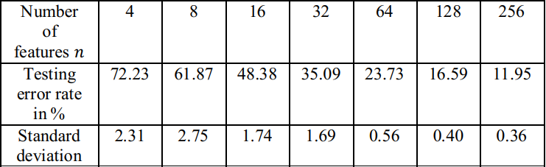
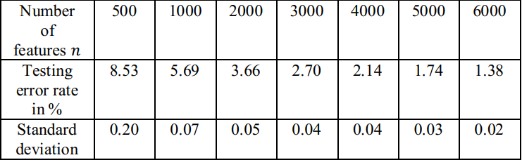

Random features
(used as reference)
Classification error approximated experimentally is
5
Notes:
5
We compared various wide neural networks with differently generated W1 matrices. First, WNN were generated for random features.
This table shows the mean values of the testing error rates and their standard deviations for the neural network sizes changing from 2 to 6000 neurons in the hidden layer. The results were obtained by averaging 20 runs with randomly generated weight matrices in the range -0.1 to 0.1.
In order to determine the error convergence rate, we tested many wide neural networks on the MNIST data set, varying the number of neurons in the hidden layer a.k.a. (also known as) features.
The results were obtained by averaging 20 runs with randomly generated weight Matrices W1. We observed, that after normalization, results are slightly better, these results are presented on the screen. We can see clearly, that error converges (notice green arrows) to some small value, when we enlarge the number of features.
Observe a result marked red. It gives better than chance recognition, which after on-hot-encoding is 90%, while this is only 4 features.
We obtained empirically equation f(n) to match the results.

Slide 6
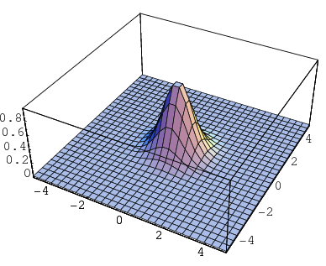
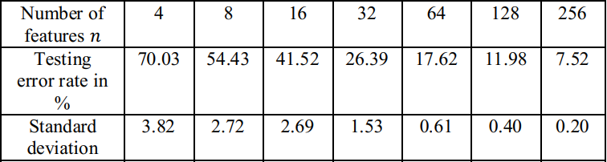
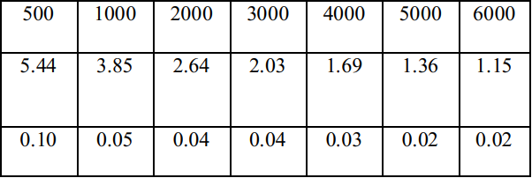


Radial Basis Features
Hidden neurons function:
Distance between the input data and a hidden neuron :
Mean value of norms of differences between weights of hidden neurons:
6
Notes:
6
Next, we tested MNIST data recognition using a new set of features based on radial basis functions to determine the interconnection weights from the input data to hidden neurons. To obtain RBF for individual hidden neurons, we first generated their input weights as equal to the coordinates of the randomly selected training data. Each hidden neuron had a logistic function described by f(x). where x is the input data vector, w is the vector of weights of the hidden neuron, d(x, w) is the distance between the input data and a hidden neuron and d-dash is the mean value of norms of differences between weights of hidden neurons (or coordinates of selected training data vectors) for all pairs of hidden neurons. Each hidden neuron calculates its own logistic function value based on the distance of the input data x to its weights vector w. We used the average mean for all dimensions equal to d = 20.2 and the standard deviation σ = 3.74 to design radial basis functions for hidden neurons.
Values d(hypen) and σ are calculated only once after the random selection of training data points. During testing, each hidden neuron calculates its own logistic function value based on the distance of the input data x to its weights vector w.

Slide 7
Comparison of random and radial basis feature selection approaches
RANDOM FEATURE SELECTION
RADIAL BASIS FEATURE SELECTION
7
Notes:
7
As we can see, the radial basis feature selection approach achieves better performance of the wide neural network than the random feature selection approach.

Slide 8
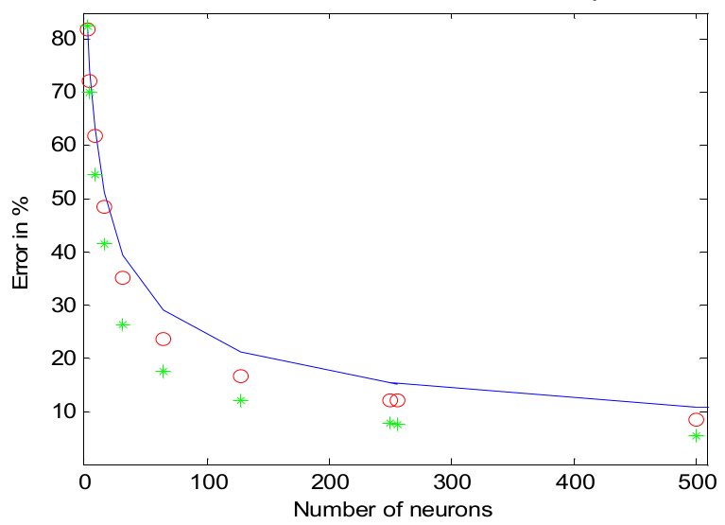

Random vs
Radial Basis Features
$$\frac{1}{\sqrt{n}}$$
RND
RBF
Open question: how significant the improvement can be?
8
Notes:
8
The results from the previous two tables are depicted on the screen. As we can see that these results are more accurate than the results for a random selection of features. Thus, the better selection of features of wide neural networks resulted in better performance.
The question is, how significant is this improvement? And how much improvement we can get from it?

Slide 9
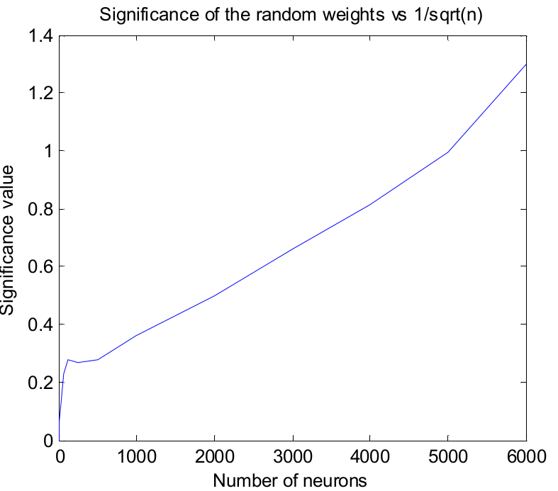
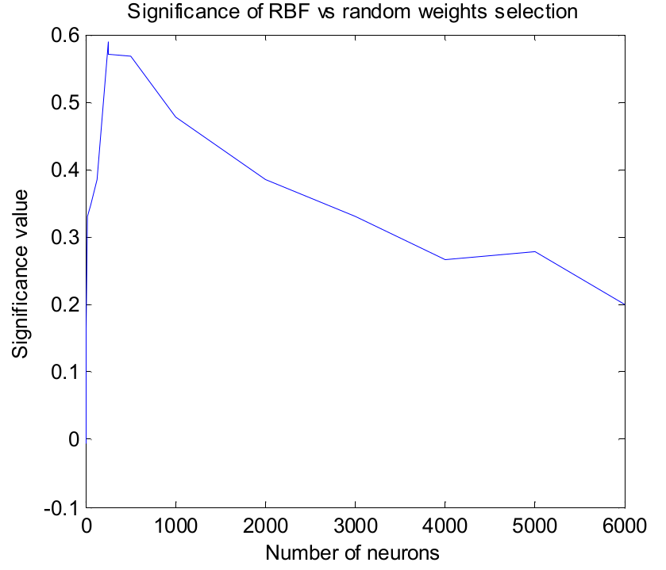
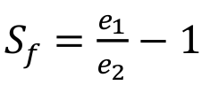
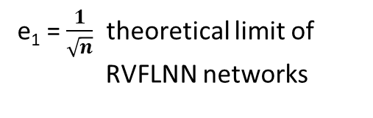

Feature Significance
$$\frac{1}{\sqrt{n}}$$
Random weights are always better from the reference weights,
and this advantage is still better along with the number of neurons
RBF weights are always better than random weights in range of 0 and 6000 neurons, but this benefits are diminishing along with the number of neurons.
e₁ = $\frac{1}{\sqrt{n}}$ theoretical limit of
RVFLNN networks
e₁ – for random weights W₁
e₂ – for RBF weights W₁
e₂ – for random weights W₁
9
Notes:
9
To be able to answer this question in quantitative terms, we introduce here a feature significance measure. The random selection of weights is only used as a reference. Any feature selection method that gives better results than the random selection in lowering the recognition error should have the significance higher than 0, and those that give worse result should have the significance lower than 0. One way of measuring the feature significance will be to use the ratio of errors for the two methods compared (for a specific number of the hidden nodes).
Note, that e1 is a reference and -1 is a shifting factor towards 0, i.e. Sf=0 when e1=e2.
It is a quick and easy check if one method is better than another. The better method will have a systematically positive value of the significance measure and the bigger the significance measure is, the better the feature selection method is.

Slide 10
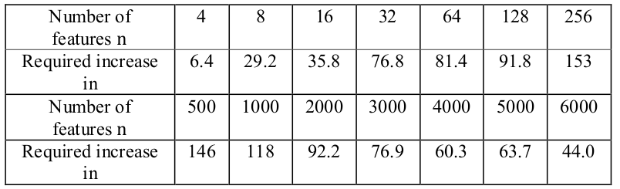
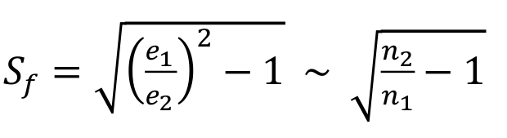

% increase of RND relative to RBF
10
Notes:
10
Another approach to defining the feature selection significance is to relate it to the number of nodes in the hidden layer of the worse method needed to obtain a similar accuracy of classification results as obtained by the better method.
Note, that Sf is a selection significance and Sf² (Sf squared) is multiplication factor of the lesser method neurons increase, to finally match the better method performance.
We can see that in the random selection of weights, the number of neurons needed to obtain an error that matches the one of RBF should be increased between 6-150%, which indicates large savings in the number of neurons and simulation time if RBF features are used to build wide neural networks.

Slide 11

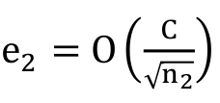
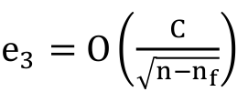
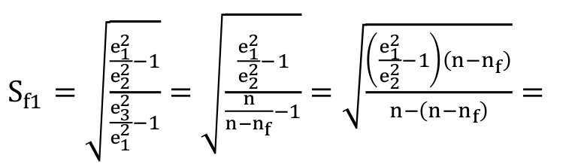
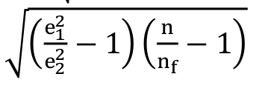
Incremental Feature Significance
Suppose we have n features and want to add n_{f} new features
We want to measure n_{RND} features can be saved if n_{f} will be added
e.g.
11
Notes:
11
Suppose that we already have a number of features n in a wide network and would like to add a specific number n of new features that we believe are good features for a given problem. Thus, we wish to have an incremental significance measure that evaluates how many randomly generated features can be saved if the new features are used. The measure should tell us how much better is to use these new features than those randomly generated. The savings are specifically addressed to a subset of all features instead of replacing all features as we had in the previous case.
Sf1 is an extension of Sf, from previous slide. e1 is the error level produced by the network using only the original set of nf features, e2 is the error level produced by the network in which n features were replaced by the new set of features, and e3 is the level of the estimated error for the original features with nf features removed.
If we assume, that reference features were randomly generated, we end up with the relationship depicted in a green field.

Slide 12
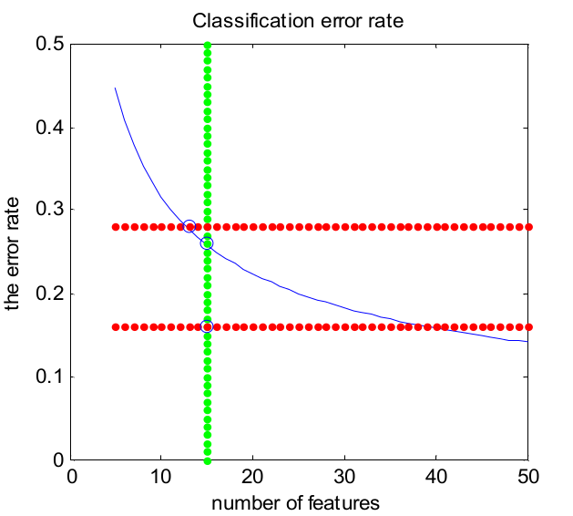


Example A
e₁
e₂
n
12
Notes:
12
Let’s illustrate the incremental feature selection significance on an example. Let’s assume that the error rate was e1= 0.26 for n=15 and when two random features were replaced by selected features (i.e. n = 2) we got the error rate e2 = 0.16. We can calculated the incremental significance of these features as Sf1 = 2.01
The continuous line represents the theoretical error level estimated by O(1/√n ), on the vertical line, we have errors e1 and e2, the top horizontal line intersects the curve O (1 ⁄ √n) yielding the estimated error e3 , and the bottom horizontal line intersects O(1 ⁄ √n) giving an estimate of the number of random features n2 that would yield the same level of the error level e2.
It would take more than twice the current number of random features (about 15) to reach the same error level (around 0.16).

Slide 13

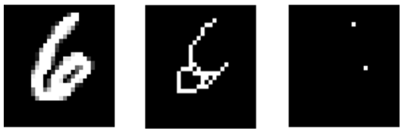
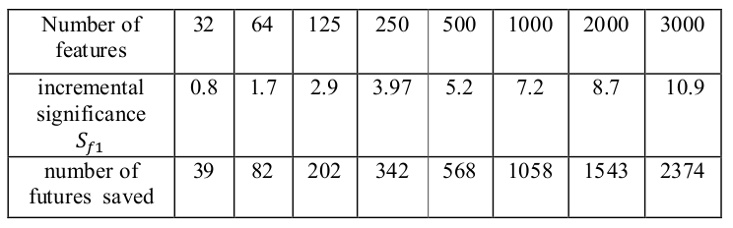

Example B
13
Incremental significance of endpoint features
Notes:
13
Let’s now check how significant are these extra features represented by the coordinates of the endpoints of the digits? To answer this question, we tested wide neural networks with various numbers of hidden neurons. This resulted in two types of errors: error e1 which was obtained when all features of the hidden neurons were randomly generated, and error e2 obtained in the networks in which 20 random features were replaced by 20 features representing the endpoints. Next, we calculated the incremental significance measure S and the number of saved neurons in the hidden layer if all features are based on the random selection from (delta)n.
As we can see, both the significance of the selected endpoint features and the number of random features needed to compensate for the lack of these features are increasing with the network size.

Slide 14
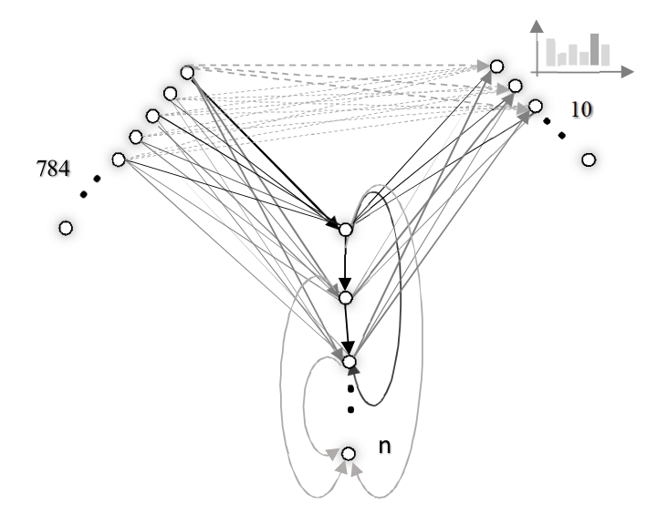
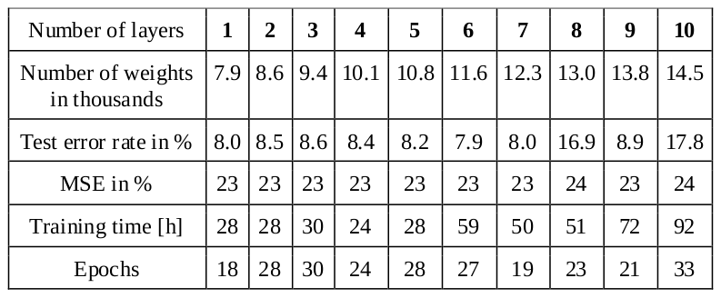
Fully Connected Cascade
No of connections (and weights to train) is 7840!
14
Notes:
14
The networks of various sizes were trained with the Levenberg-Marquardt (LM) nonlinear optimizer, aimed to minimize the mean squared output error (MSE). In order to make the test results of FCC (Fully Connected Cascade) network in agreement with the MSE error, we scaled the output vector 10 times. This improved the recognition stability of the test results. The classification results are shown in the table.
LM is the second-order training method. In practice, the second-order derivatives matrix inversion should be computed every time the weight will change. As we can see, the training of this network is very slow. The fastest training time was 24h. Thus, we conclude that the LM method is not suitable for practical problems of this size. Moreover, the FCC was not designed to be deep in the sense of the today standards.

Slide 15
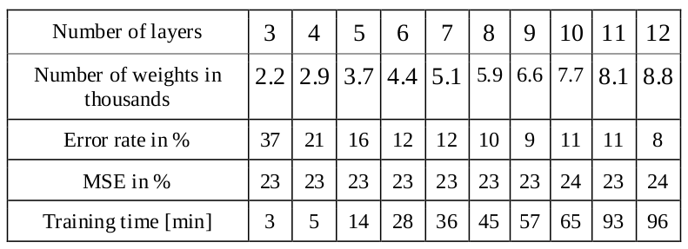
Modified Cascade
15
Notes:
15
A Modified Cascade network (without layer 0 connections) is notably more compact, thus faster. Table VI presents the results of this modification. An error converges to ~ 9% in deeper networks with a standard deviation of 1%. Comparing to results presented in the previous Table, training time (here in minutes) is significantly smaller.
Overall, we did not find the FCC network to be competitive with wide networks of a similar level of complexity. First, the FCC network has a delay proportional to the number of cascaded nodes. Second, the number of weights must be much bigger to reach the same test accuracy, which increases the training time.

Slide 16
Summary & Future Plans
16
We discussed the significance of the feature selection for wide neural networks.
We compared recognition accuracy on the MNIST dataset using two approaches.
We compared wide networks to connected cascades.
We introduced two simple feature significance measures.
In future, we want to explore tradeoffs between the number of hidden neurons in wide neural networks vs. width and depth of deep neural networks to better understand tradeoffs between the two parameters in these modern network structures.
Notes:
16
This paper discussed the significance of the feature selection for wide neural networks. Obtained experimentally, the testing accuracy confirmed claims that the testing error decreases with the increasing number of hidden neurons, although there are significant differences in the performance of different feature selection methods for the same number of hidden neurons. We compared recognition accuracy on the MNIST database using two approaches: 1) randomly selected weights from the input layer to hidden neurons, and 2) weights based on radial basis functions. Both methods gave wide neural network structures without expensive iterative learning that characterize deep neural networks. It requires only a pseudoinverse to train the output layer that classifies the input data. However, the selection of weights using radial basis functions required a smaller number of hidden neurons to obtain a similar level of recognition accuracy. We also compared wide networks to connected cascades and demonstrated that these techniques are not competitive with wide networks although their simplicity in construction.
To measure the quality of the applied feature selection method, we introduced two significance measures. The first measure compared two methods of feature selection applied to all hidden neurons. The second method allowed for increment testing of selected features while leaving the remaining features without change. This second approach is particularly useful to test a smaller number of specifically selected features that may require special preprocessing of data to establish the features. In addition, we can translate the feature significance into the number of random features that would have to be added to the wide network in order to obtain a similar performance as the network with added (possible more elaborate) features. In future work, we want to explore tradeoffs between the number of hidden neurons in wide neural networks vs. width and depth of deep neural networks to better understand tradeoffs between the two parameters of the modern neural network structures.

Slide 17

謝謝
Janusz A. Starzyk
starzykj@ohio.edu
Google: Janusz Starzyk
Rafał Niemiec
rniemiec@wsiz.rzeszow.pl
Google: Rafał Niemiec
Adrian Horzyk
horzyk@agh.edu.pl
Google: Horzyk
Basawaraj, J. A. Starzyk, A. Horzyk, Episodic Memory in Minicolumn Associative Knowledge Graphs, IEEE Transactions on Neural Networks and Learning Systems, Vol. 30, Issue 11, 2019, pp. 3505-3516, DOI: 10.1109/TNNLS.2019.2927106 (TNNLS-2018-P-9932), IF = 7.982.
J. A. Starzyk, Ł. Maciura, A. Horzyk, Associative Memories with Synaptic Delays, IEEE Transactions on Neural Networks and Learning Systems, Vol. .., Issue .., 2019, pp. ... - ..., DOI: 10.1109/TNNLS.2019.2921143 (TNNLS-2018-P-9188), IF = 7.982.
A. Horzyk, J. A. Starzyk, J. Graham, Integration of Semantic and Episodic Memories, IEEE Transactions on Neural Networks and Learning Systems, Vol. 28, Issue 12, Dec. 2017, pp. 3084 - 3095, DOI: 10.1109/TNNLS.2017.2728203, IF = 6.108.
A. Horzyk, J.A. Starzyk, Fast Neural Network Adaptation with Associative Pulsing Neurons, IEEE Xplore, In: 2017 IEEE Symposium Series on Computational Intelligence, pp. 339 -346, 2017, DOI: 10.1109/SSCI.2017.8285369.
A. Horzyk, Neurons Can Sort Data Efficiently, Proc. of ICAISC 2017, Springer-Verlag, LNAI, 2017, pp. 64 - 74, ICAISC BEST PAPER AWARD 2017 sponsored by Springer.
A. Horzyk, J. A. Starzyk and Basawaraj, Emergent creativity in declarative memories, IEEE Xplore, In: 2016 IEEE Symposium Series on Computational Intelligence, Greece, Athens: Institute of Electrical and Electronics Engineers, Curran Associates, Inc. 57 Morehouse Lane Red Hook, NY 12571 USA, 2016, ISBN 978-1-5090-4239-5, pp. 1 - 8, DOI: 10.1109/SSCI.2016.7850029.
17
Notes:
17
W Chińskim tradycyjnym dziękuję: sije sije.

Slide 18
Pseudoinverse Z₂⁺=VΣ⁺U^{T}
C(Z₂)
Projections, where possible
Z₂ = UΣV^{T}
ΣΣ⁺ = ~I
Σ⁺Σ = ~I
Z₂⁺ = (UΣV^{T})⁺ = VΣ⁺U^{T}
Minimum norm least square solution W₂ ~= Z₂^{+ } Y_{D}
Matrix Methods in Data Analysis, Signal Processing, and Machine Learning
& WIPE nullspace
m x m
σ₁ 0 0
Σ = 0 σ₂ 0
0 0 0
1/σ₁ 0 0
Σ⁺ = 0 1/σ₂ 0
0 0 0
n x n
m x n
n x m
C(Z₂^{T})
18
Notes:
18
Pseudoinverse is about the projections. We start from A^{T}A = VΣ^{T}(U^{T}U)ΣV^{T}=V(Σ^{T}Σ)V^{T}; V’s are eigenvectors of A^{T}A; Σ^{T}Σ: σ²: eigenvalues of A^{T}A. And AA^{T} = UΣ(V^{T}V)Σ^{T}U^{T} = U(ΣΣ^{T})U^{T}, but will not use U’s from here. This is a concept, but unfortunately without a guarantee that U’s will be orthogonal to V. We compute U’s directly from AV = ΣU, u_{i}=Av_{i}/σ_{i}, where i in 1:r and r>0. We will find out, if u_{i}^{T}u_{j}=0: (Av_{i}/σ_{i})^{T}(Av_{j}/σ_{j}) = v_{i}^{T}A^{T}Av_{j}/σ_{i}σ_{j} = v_{i}^{T}σ_{j}²v_{j}/σ_{i}σ_{j} = (σ_{i}/σ_{i})v_{i}^{T}v_{j} = 0. So it works. We have no nullspace.
Next we invert A=UΣV^{T}. A⁺=(UΣV^{T})⁺=VΣ⁺U^{T}.
That’s the way we compute weights. Namely Y_{D}=Z₂*W₂, Z₂⁺Y_{D}=Z₂⁺Z₂W₂=IW₂=W_{2.}

